Slide 1
Reconfigurable SoC-Based Smart sensor for wavelet and wavelet packet analysis
Igor Peric
Daniel Barmaimon

Slide 2
Index
Introduction
Theoretical Background
Smart Sensor Implementation
Experimentation and Results
Conclusion

Slide 3
Introduction
Measured signals:
  Current
  Voltage
  Vibrations
Time/frequency analysis is usually needed in industrial applications.
High performance
Low cost primary sensors
Online signal processing
Monitoring system
Notes:
Monitoring systems needs
Some of the most sensed signals…

Slide 4
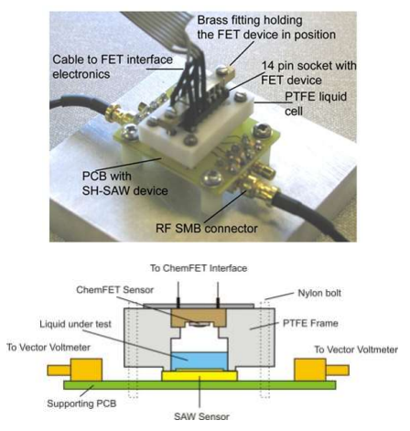
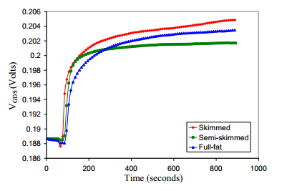
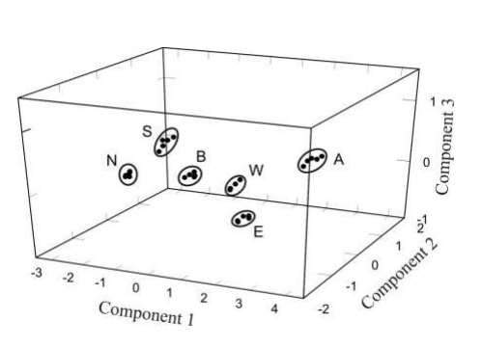
System-on-Chip concept
Applications:
  Flavor analysis for liquids
  Detecting hydrogen leaks and [NOx]
  DC power grid protection
  High resolution frequency estimation
  Machine fault diagnosis (DC motors, etc)
Notes:
Able to differenciate between different liquids, and between different kind of milks

Slide 5
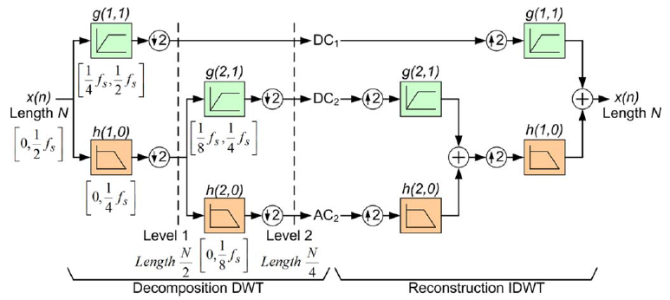
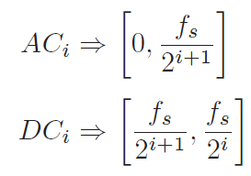
Discrete Wavelet Transform (DWT)
Uses dicrete time low- and high-pass filters, h(i,j) and g(i,j), followed by downsampling operation for each decomposition level

Slide 6
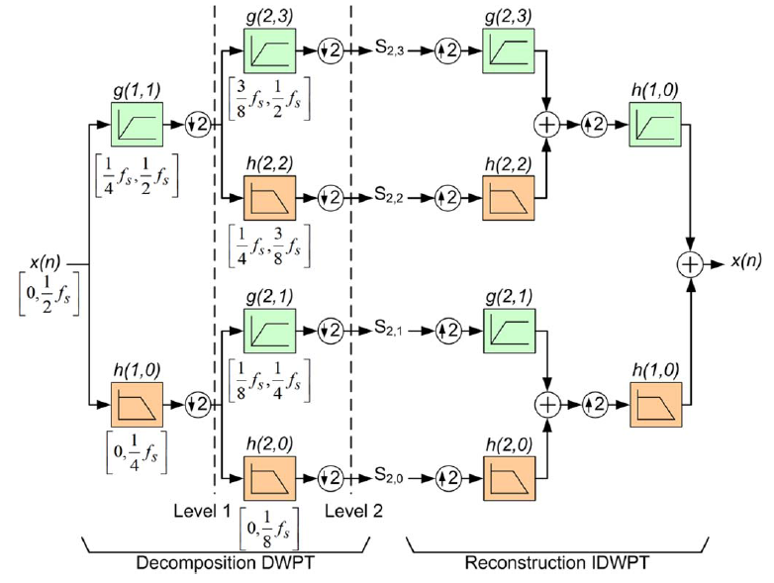
Discrete Wavelet Packet Transform (DWPT)
Detailed and approximation coefficient are calculated for low and high frequency bands is the only difference with respect to DWT.

Slide 7
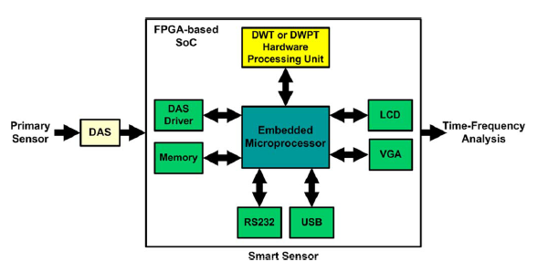
Smart sensor implementation

Slide 8
Embedded microprocessor
8-bit Harvard-arquitecture microprocessor
Customized for register transference and interrupt management
It will speed up program execution and reduce power consumption
Main task: Coordinate information exchange between components

Slide 9
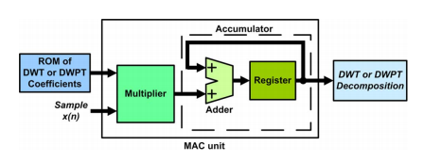
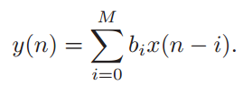
DWT or DWPT Harware Processing Unit

Slide 10
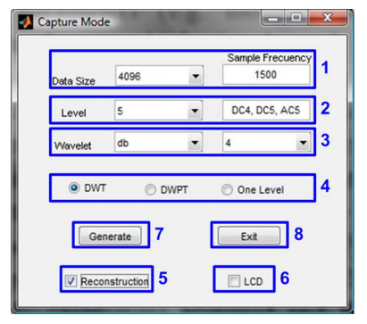
Reconfiguration GUI
Number of samples and sampling frequency
Maximum decomposition level and frequency bands of interest
Mother wavelet to be applied, which corresponds to any of the mother wavelet functions available in MATLAB
Used algorithm (DWT or DWPT)

Slide 11
Experimental data and results

Slide 12
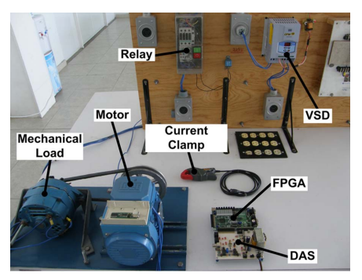
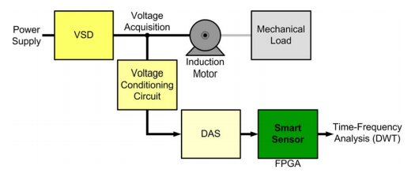
Voltage signal analysis
VSD controls the speed of the motor
Control signals sent by VSD are analyzed
16 bit A/D converter is used for DAS

Slide 13
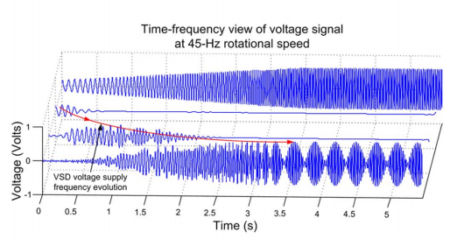
Results

Slide 14
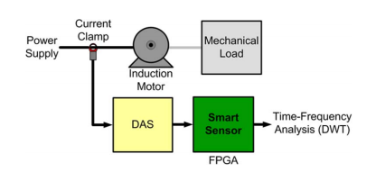
Electric current signal analysis
Induction motor transient current signal during startup can be used to analyze faults
Current provided by power supply is measured

Slide 15
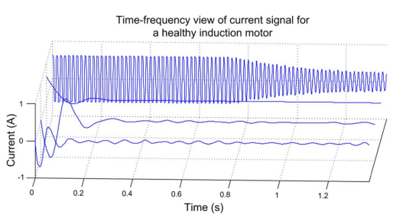
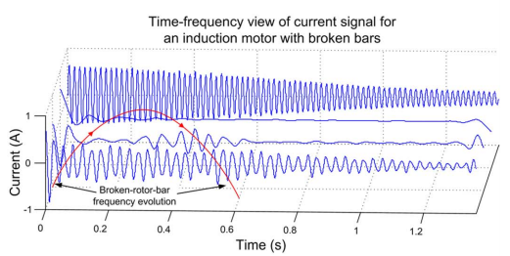
Results

Slide 16
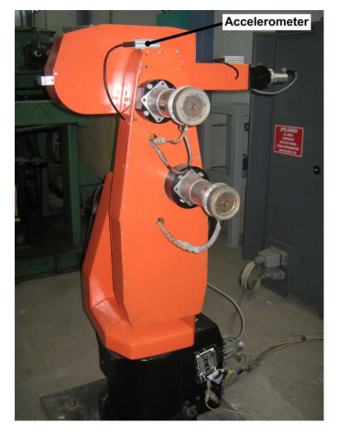
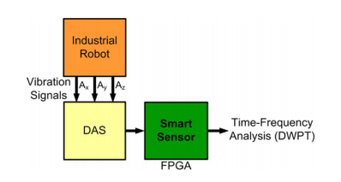
Vibration signal analysis
Analyzing 3-axis vibration using accelerometer

Slide 17
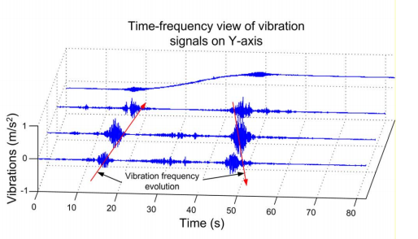
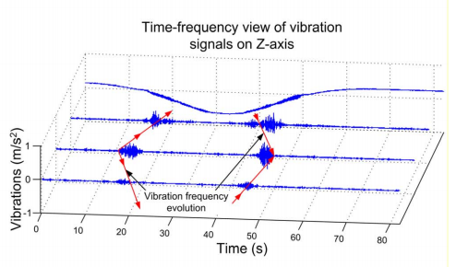
Results

Slide 18
Conclusions
Low cost smart sensor architecture
High portability and versatility
Reconfigurable for different sensors and bands
  Re-programmable FPGA architecture used
  Configuration done using software
Fast real time frequency analysis, providing frequency evolution monitoring and fault detection

Slide 19
Thank you!

